Slide 1
Using Sensor Data and ML to Estimate Room Occupancy
Jeffrey Fitzpatrick
500728133

Slide 2
Room Occupancy Estimation dataset
Available from the UC Irvine Machine Learning Repository
Contains 10129 datapoints and 16 features
Each feature represents data from a particular sensor
Temperature
Light
Sound
Motion
CO2
Measurements were taken over several days in 30 second increments
No missing values in the dataset

Slide 3
Research Questions
For my project I chose the theme of Classification for building predictive models
To reduce energy consumption in buildings, I investigated these research questions:
Which of the implemented supervised learning techniques perform the best in predicting occupancy?
Which types of sensor data (temperature, light, sound, motion, CO2) show the most promising results?
Based on the research, what alternative types of sensor data could be used for ML-based occupancy estimation
Aim of this project is to compare my results with the results of earlier studies on the same dataset

Slide 4
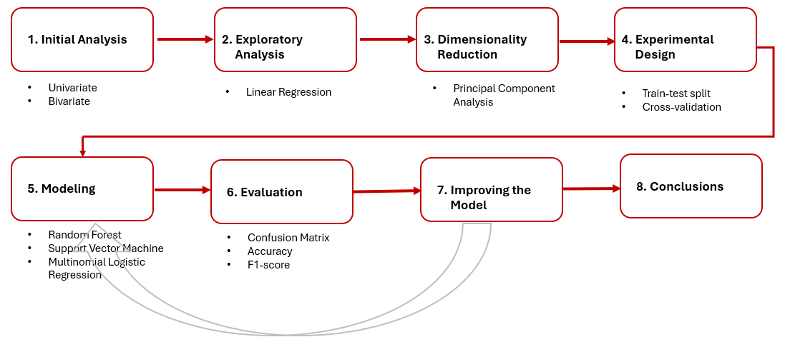
Applied Methodology and Study Design

Slide 5
Initial Analysis: Data Dictionary
Field Name | Data Type | Description
Date | Date | Date of observation in YYYY/MM/DD
Time | Date | Time of observation in HH:MM:SS
S1_Temp, S2_Temp, S3_Temp, S4, Temp | Continuous | Temperature reading in degrees Celsius
S1_Light, S2_Light, S3_Light, S4_Light | Integer | Light reading in lux
S1_Sound, S2_Sound, S3_Sound, S4_Sound | Continuous | Sound reading in volts (amplifier output read by ADC)
S5_CO2 | Integer | CO2 reading in ppm
S5_CO2_Slope | Continuous | Derived slope of C02 values
S6_PIR, S7_PIR | Binary | Binary value conveying motion detection
Room_Occupancy_Count | Integer | Number of occupants in room (0 to 3)

Slide 6
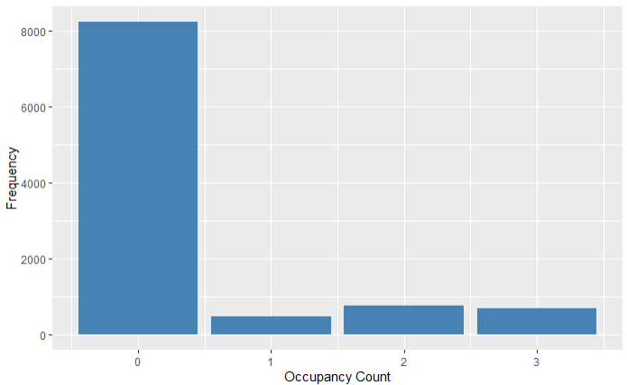
Initial Analysis: Frequency of target variable
In about 80% of the data points, the room was unoccupied

Slide 7
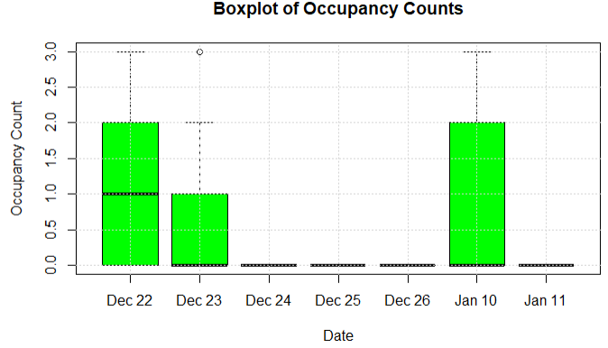
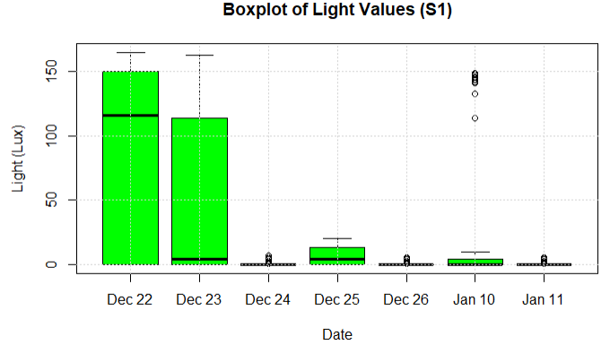
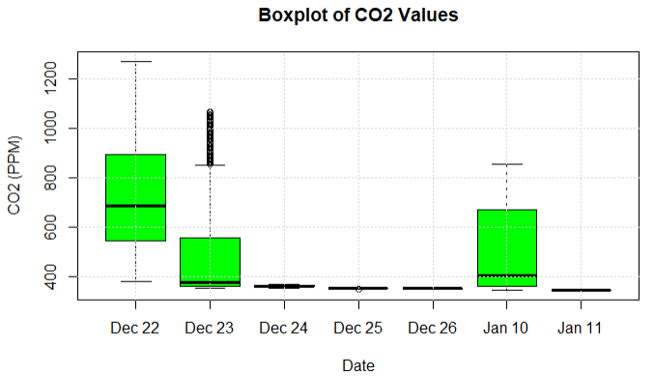
Initial Analysis: Time-Series Analysis
Occupants on Dec. 22, Dec. 23, and Jan. 10
Highest sensor values occurred on days with occupants

Slide 8
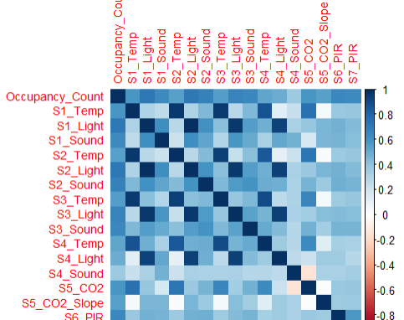
Initial Analysis: Correlation Analysis
Moderate correlation between sensor values and room occupancy
Strong correlation of light values between sensors
Relatively weak correlation of sound values between sensors

Slide 9
Exploratory Analysis: Linear Regression
Using all sensor data provide the best model fit (89.4%)
Based on the remaining models, light data had the best fit (79.2%) followed by CO2 data (74.6%)
Consistent with the introductory paper (Singh et al., 2018) which found light features performed the best overall
Sound data (44.4%) and motion data (40.1%) had the worst fit
Model to predict room occupancy | R-squared
All features | 0.894
Light data (S1_Light, S2_Light, S3_Light, S4_Light) | 0.792
CO2 data (S5_CO2, S5_CO2_Slope) | 0.746
Sound data (S1_Sound, S2_Sound, S3_Sound, S4_Sound) | 0.444
Motion data (S6_PIR, S7_PIR) | 0.401

Slide 10
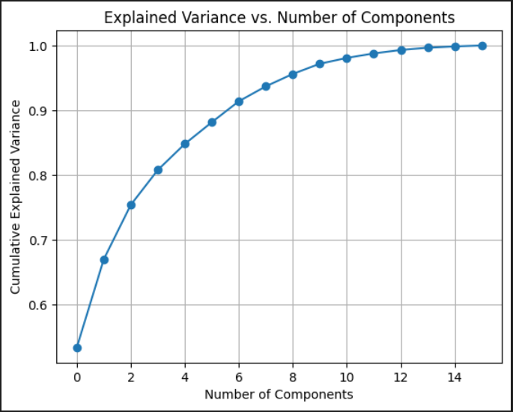
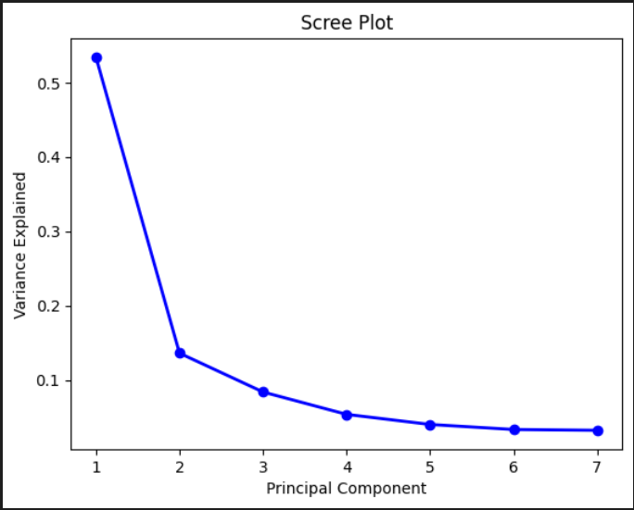
Dimensionality Reduction: PCA
7 components are needed to capture at least 90% of the explained variance
Highest contributions (first component): S1_Light, S3_Light, S1_Temp, S2_Temp, and S3_Temp

Slide 11
Experimental Design
Scaling of numerical features for Logistic Regression and Support Vector Machine (mean of approximately 0 and standard deviation approximately 1)
Split the data into training (80%) and testing (20%) sets
Applied 10-fold cross validation on the training set to test stability
Logistic Regression: Average accuracy of 99.4%
Random Forest: Average accuracy of 99.7%
Support Vector Machine: Average accuracy of 99.4%
Evaluated each model on the test set using all features
Reran each model using PCA

Slide 12
Model Evaluation: Logistic Regression
All Features
Class | Accuracy | Precision | Recall | F1-score | Support
0 |  | 99.9% | 99.9% | 99.9% | 1619
1 |  | 100.0% | 100.0% | 100% | 103
2 |  | 96.4% | 97.0% | 96.7% | 164
3 |  | 95.0% | 95.0% | 95.0% | 140
Average | 99.3% | 97.8% | 98.0% | 97.9%
PCA
 | Accuracy | Precision | Recall | F1-score
Average | 94.1% | 81.1% | 81.3% | 81.2%

Slide 13
Model Evaluation: Random Forest
All Features
Class | Accuracy | Precision | Recall | F1-score | Support
0 |  | 99.9% | 100.0% | 100.0% | 1619
1 |  | 99.0% | 100.0% | 99.5% | 103
2 |  | 99.4% | 98.8% | 99.1% | 164
3 |  | 99.3% | 98.6% | 98.9% | 140
Average | 99.8% | 99.4% | 99.3% | 99.4%
PCA
 | Accuracy | Precision | Recall | F1-score
Average | 99.1% | 96.9% | 97.5% | 97.2%

Slide 14
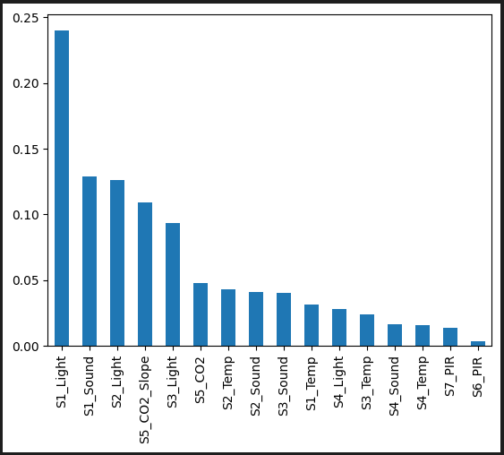
Random Forest: Importance of each feature
Most important features:
S1_Light
S1_Sound
S2_Light
S5_CO2_Slope
Least important features:
S7_PIR
S6_PIR

Slide 15
Model Evaluation: Support Vector Machine
All Features
Class | Accuracy | Precision | Recall | F1-score | Support
0 |  | 100.0% | 99.8% | 99.9% | 1619
1 |  | 100.0% | 100.0% | 100.0% | 103
2 |  | 96.9% | 96.3% | 96.6% | 164
3 |  | 93.8% | 96.4% | 95.1% | 140
Average | 99.3% | 97.7% | 98.1% | 97.9%
PCA
 | Accuracy | Precision | Recall | F1-score
Average | 99.3% | 97.7% | 98.0% | 97.8%

Slide 16
Conclusions: Summary of Model Results
All features: Random Forest performed the best in terms of accuracy and F1-score (consistent with Mao et al., 2023)
PCA: Support Vector Machine performed the best in terms of accuracy and F1-score (Singh et al., 2018 concluded that good results could be achieved with only 4 components)
 | All Features |  |  | PCA
Model | Accuracy Training Set | Accuracy Test Set | F1-Score Test Set | Accuracy Test Set | F1-Score Test Set
Logistic Regression | 99.4% | 99.3% | 97.9% | 94.1% | 81.2%
Random Forest | 99.7% | 99.8% | 99.4% | 99.1% | 97.2%
Support Vector Machine | 99.4% | 99.3% | 97.9% | 99.3% | 97.8%

Slide 17
Conclusions: Summary of Sensor Data
Light features performed the best overall
However, light relies on occupants turning on lights when they arrive and turning them off when they leave (Singh et al., 2018)
CO2 data showed promising results
Best approach is to use a combination of different types of sensor data including CO2
Alternative types of sensor data include Bluetooth signals, Wi-Fi, camera images, GPS data, UWB radar, and electric meters
Limitations such as high cost, limited range, false results, and privacy issues may prevent them from being widely adopted (Khan et al., 2024)

Slide 18
Limitations and Future Work
Assumptions of linear regression and logistic regression
Linear relationship between independent variables and dependent variable
Independent variables are not correlated with each other
In this dataset, the sensor data is correlated with each other (multicollinearity)
P-values and coefficients in linear regression models may not be reliable
Outliers were detected in the temperature, light, sound, and C02 data
Future Work
Hypothesis testing to determine significance of model results (Friedman)
Feature selection (e.g., removal of light features)
Using PCA with fewer features
Evaluation of more classification algorithms

Slide 19
References
Singh, A.P., Jain, V., Chaudhari, S., Kraemer, F.A., Werner, S., & Garg, V. (2018). Machine learning-based occupancy estimation using multivariate sensor nodes. IEEE Globecom Workshops (GC Wkshps), 1-6. https://doi.org/10.1109/GLOCOMW.2018.8644432
Mao, S., Yuan, Y., Li, Y., Wang, Z., Yao, Y., & Kang, Y. (2023). Room occupancy prediction: Exploring the power of machine learning and temporal insights. American Journal of Applied Mathematics and Statistics. https://doi.org/10.48550/arXiv.2312.14426
Khan, I., Zedadra, O., Guerrieri, A., & Spezzano, G. (2024). Occupancy prediction in IoT-enabled smart buildings: technologies, methods, and future directions. Sensors, 24(11). doi.org/10.3390/s24113276

Slide 20
Thank you

